Slide 1
Harmonizing a Melody using Transformer Model

Slide 2
Goal and Definitions
Our goal is to develop a generative ML model which will take a melody sequence as an input and should output an accompanying harmony.
Melody: a series of musical notes which is perceived as a single contiguous entity.
In the most basic definition, a melody or musical line can be described as a combination of pitch and rhythm.
Harmony: musical pitches which coincide with another musical line to provide synergistic accompaniment.
Harmony can be comprised of multiple pitches with different rhythm as the melody.

Slide 3
Intro to Transformers
The Transformer is a recent paradigm shifting model in machine learning, designed for use in tasks involving sequential data.
The transformer, based on the self-attention mechanism, was introduced in the paper “Attention Is All You Need [Vaswani et al., 2017].
Since then, transformer models have become the standard for many sequential ML tasks, including
Natural Language Processing
Document summarization/generation
Machine translation
And of course the transformer’s most well know use case: ChatGPT.

Slide 4
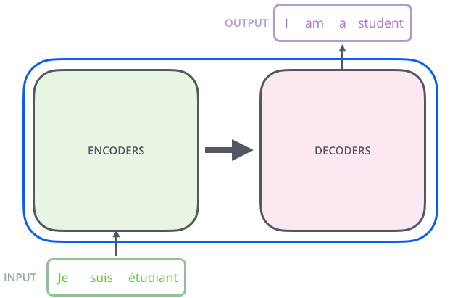
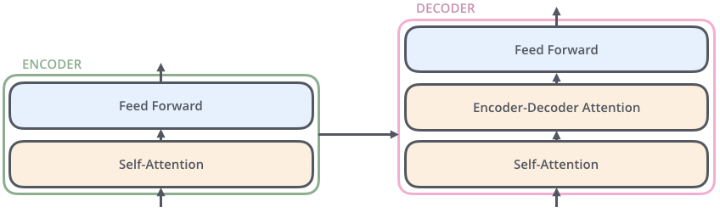
Intro to Transformers
At a high level, the transformer takes an input sequence (in this case, a French sentence) and gives an output sequence (hopefully, a semantically equivalent translation in English).
Internally, the transformer contains:
Encoder: takes the input sequence and applies self-attention and a standard MLP network to it.
Decoder: takes the input sequence and the previous outputs, applying self-attention, a decoder specific attention mechanism, and another MLP network to produce a predicted output.

Slide 5
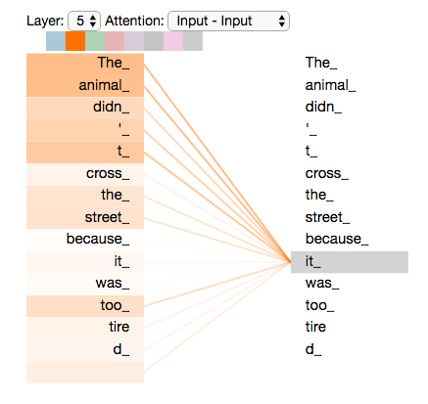
Intro to Transformers
Self-attention: a mechanism which allows the transformer to focus on different parts of the input sequence by computing attention weights which correlate all parts of the input. These attention weights capture the relevance of each element relative to the others.
“The animal didn’t cross the street because it was too tired.”
This allows the model to make long term correlations between items in the sequence.
Attention mechanism is showing a high
learned correlation between “animal” and
“it”, showing it has learned what to associate
the semantically ambiguous pronoun
See the Illustrated Transformer for a somewhat gentle
overview of the transformer model and self-attention

Slide 6
Data Availability and Representation
Like all machine learning models, a large and high quality dataset is key for the performance of the trained model.
Many data sets of audio files of a variety of musical genres exist.
However, using audio data directly will complicate the network architecture substantially and require a lot of training time.
Thus, for this demonstration we will treat this task as a natural language processing task.
Melody and harmony will be represented symbolically.
Our model should read the melody in some symbolic representation and predict a harmony in a similar representation corresponding to each melody time step.

Slide 7
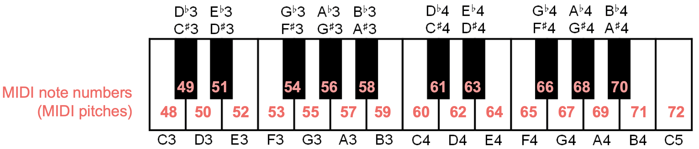
Data Availability and Representation
MIDI is a technical standard describing a communication protocol and digital interface for playing, editing, and recording music.
Each note in a piece of music is represented in pitch by its MIDI number:
Each note is represented by an integer number corresponding to its pitch in the western musical system (A, B♭, C#, etc.)

Slide 8
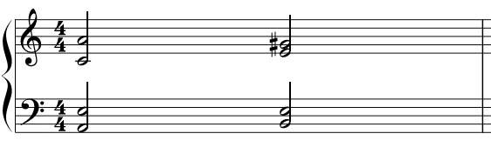

Data Availability and Representation
A piano roll matrix is a useful representation of music in a computational context:
The piano roll matrix is a N row x V column array where N is the number of timesteps in the piece and V is the number of voices.
We can choose to let each column indicate some time step, such as a quarter note in the example below.
Since each note is a half note, we will repeat the notes for two quarter note time steps
This data representation scheme requires a fixed resolution and the same number of voices for all piece in the data set.
S
S
A
T
B
$$\left[\begin{matrix}69 & 60 & 52 & 45 \\ 69 & 60 & 52 & 45 \\ 68 & 64 & 52 & 47 \\ 68 & 64 & 52 & 47\end{matrix}\right]$$
A
T
time
B
melody
harmony

Slide 9
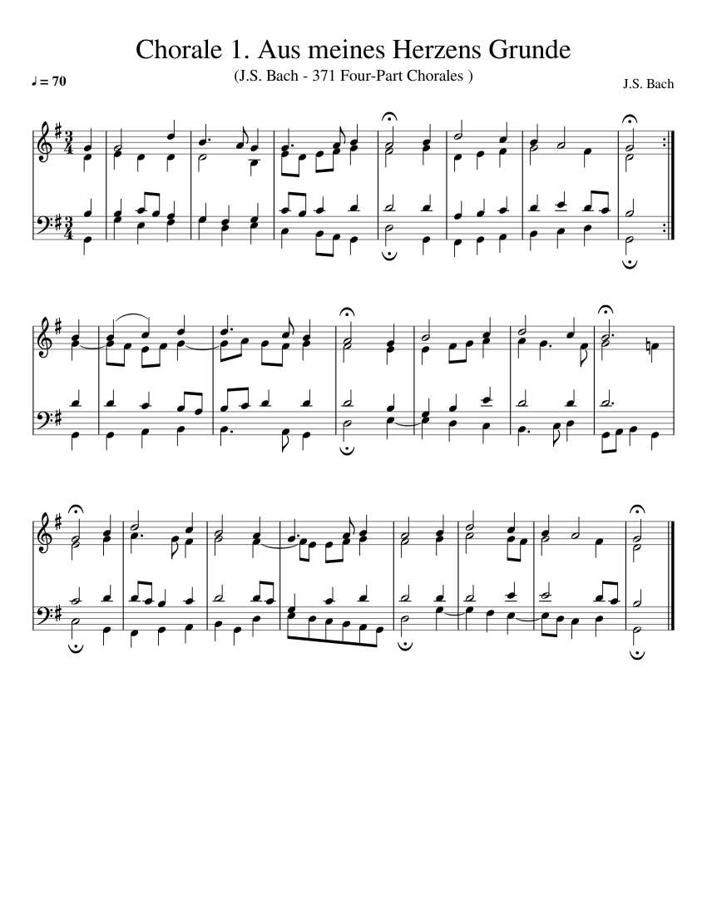
Data Availability and Representation
A suitable data exists for this purpose: the collection of chorales by Johanne Sebastian Bach, available here.
A chorale is a short, 4-part musical setting of a Lutheran hymn. Their short and uniform musical structure make them an ideal candidate for a data set for our task.
The data repository has already translated the chorales into multiple formats available for download, including:
JSON files
Python pickle files
NumPy binary files (for ease of use with PyTorch, we’ll use this data format).
Additional data cleaning and formatting has been done for this demonstration, ask if you are interested!

Slide 10
Melody Harmonization - PyTorch
Open the Jupyter Notebook named melody_harmonize_transform_template.ipynb
Cell 1 imports our base NumPy, PyTorch, and other libraries and modules.
Cell 2 iterates through our entire data set and collects all unique melody notes and harmony chords in to a set data structure.
Cell 3 creates mappings between our notes/chords and unique integer indices using a dictionary. This is because the transformer requires our sequence elements to be represented as indices in our vocabulary. This cell also defines functions to translate between indices and notes/chords and vice-versa.
Cell 4 defines our custom data set class, which we need to parse the particular format of the data arrays. The data set class will read our data array, insert special tokens, and breaks the chorales into sequences of a length of our choosing.
You don’t have to edit any of these cells!

Slide 11
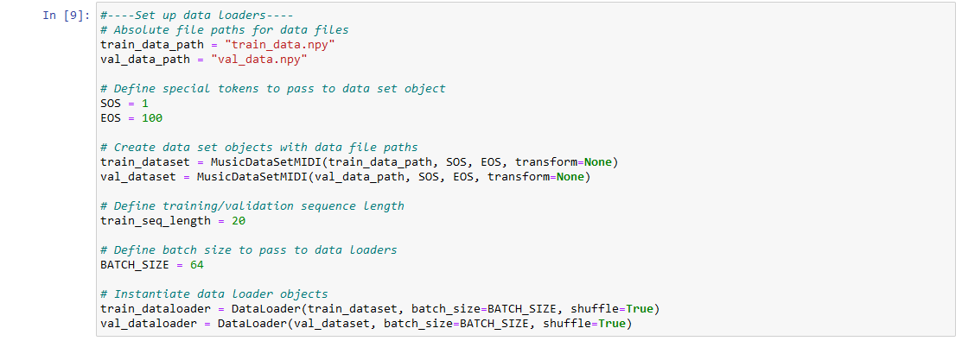
Melody Harmonization - PyTorch
Cell 5 sets up our data loader objects. Complete the code in this cell as shown:
Don’t experiment with this!
Hyperparameter: experiment with this!

Slide 12
Melody Harmonization - PyTorch
Cells 6 and 7 define our network architecture and define the necessary mathematical operations.
The implementation is fairly complicated, so you don’t have to write any code here!

Slide 13
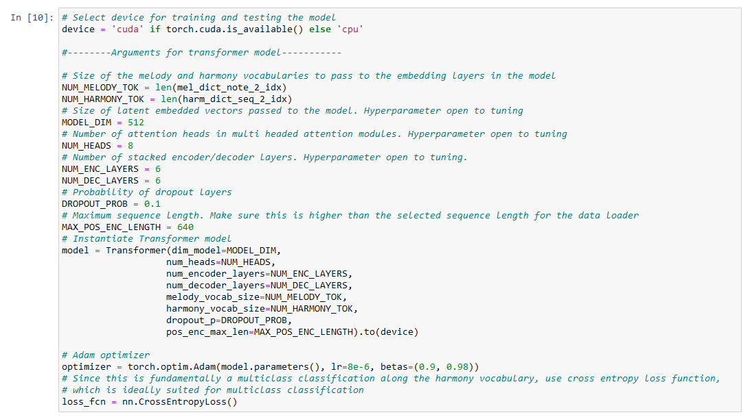
Melody Harmonization - PyTorch
Cell 8 sets our desired model parameters, creates an instance of our model, and creates our optimizer and loss function. Complete this cell as follows:
Don’t experiment with this!
Hyperparameter: experiment with this!

Slide 14
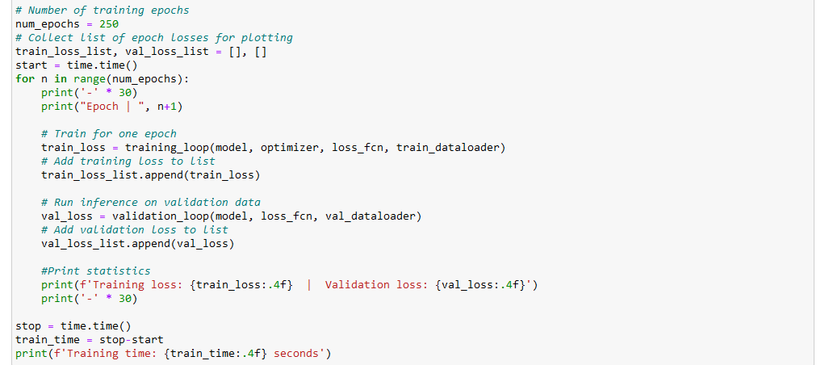
Melody Harmonization - PyTorch
Cell 9 defines our training and validation loop, which trains on the entire training data set and then performs inferences on the entire validation data set respectively. Complete the cell as shown (this code is at the bottom):
Don’t experiment with this!
Hyperparameter: experiment with this!

Slide 15
Melody Harmonization - PyTorch
Cell 10 plots the training and validation losses per epoch.
Cell 11 defines our inference loop, where we will pass a melody and generate a harmony to test our model.
No new code is needed in these cells!

Slide 16
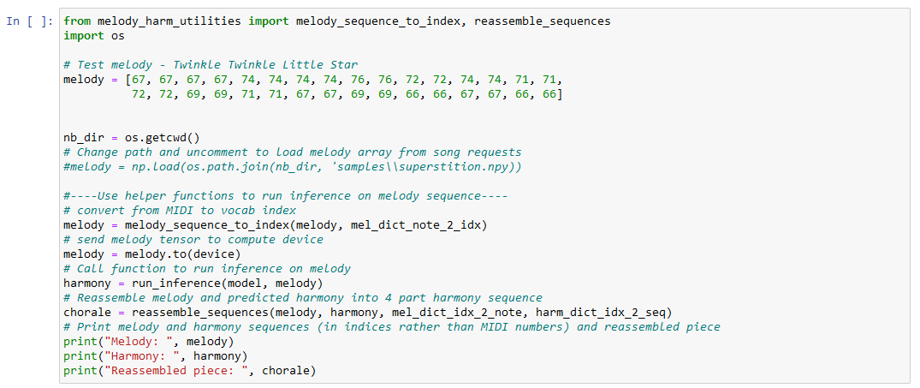
Melody Harmonization - PyTorch
Cell 12 defines/loads a melody sequence and passes it to our inference loop to predict a harmony.
Uncomment this line to load sample melodies

Slide 17
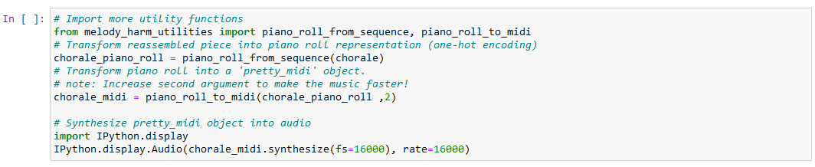
Melody Harmonization - PyTorch
Finally, Cell 13 synthesizes the assembled array into a pretty_midi object (a useful Python library for MIDI manipulation) into audio. Complete the cell as follows:

Slide 18
Melody Harmonization - Conclusion
Now we’re done! Here are some options for further exploration:
Change the sample melody in cell 12 to another (stored in /samples/ folder) and see how it sounds!
Change some hyperparameters and see if your music sounds better or worse. Some of them may have restrictions, so ask if you have any questions.
Think about anything you don’t understand about the data set, model, or PyTorch implementation and ask!

Slide 19
References
Ashish Vaswani, Noam Shazeer, Niki Parmar, Jakob Uszkoreit, Llion Jones, Aidan N Gomez, Łukasz Kaiser, and Illia Polosukhin. Attention is all you need. Advances in Neural Information Processing Systems, 30, 2017.

